Slide 1

Deep Neural Networks
(AIML ZG565)
Dr. YVK Ravi Kumar
(yvk.ravikumar@pilani.bits-pilani.ac.in)

Slide 2
Session 2
(3rd May,2026)

Slide 3
Key components of DL problem

Slide 4
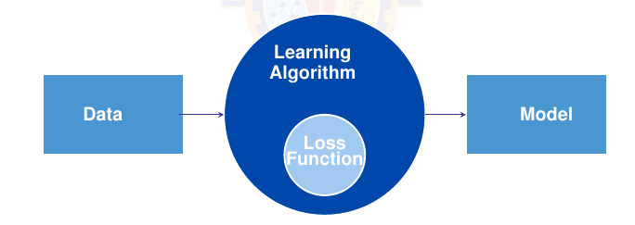
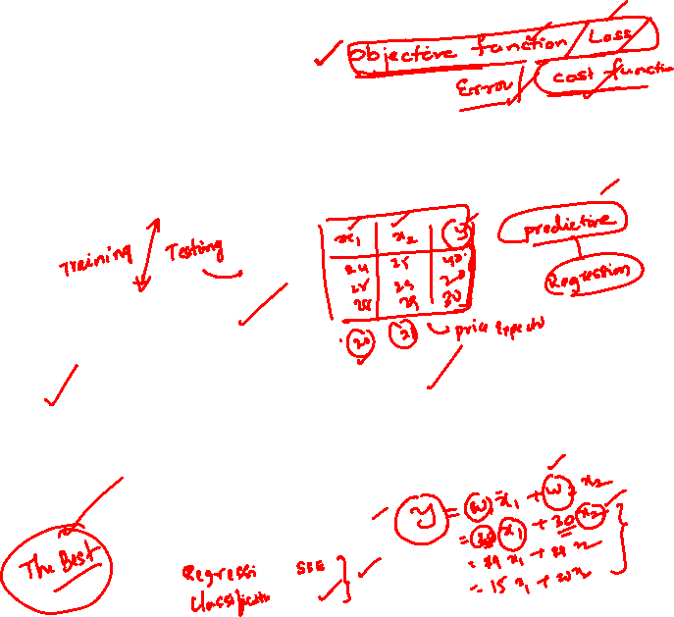
Core components of DL problem
The data that we can learn from.
A model of how to transform the data.
An objective function that quantifies how well (or badly) the model is doing.
An algorithm to adjust the modelʼs parameters to optimize the objective function.
Notes:
Refer to section 1.2. Each point is elaborated in the next slides.

Slide 5

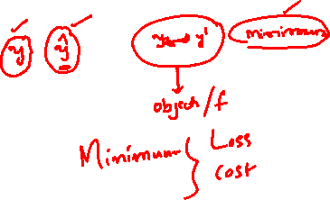
Data
Collection of examples.
Data has to be converted to an useful and a suitable numerical representation.
Each example (or data point, data instance, sample) typically consists of a set of attributes called features (or covariates), from which the model must make its predictions.
In the supervised learning problems, the attribute to be predicted is designated as the label (or target).
Notes:
We need the right data. – The data they handle might include bias (from multiple sources) which the model can capture, this can result in undesired consequences.

Slide 6
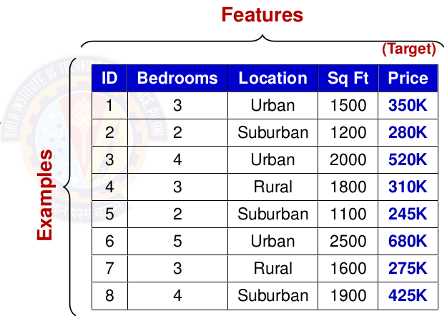
Data
Data = D = {X,t}
Number of features = Number of Dimensions = d
Number of examples = N
As the number of features increase, we say the dimensionality increases.
Notes:
We need the right data. – The data they handle might include bias (from multiple sources) which the model can capture, this can result in undesired consequences.

Slide 7
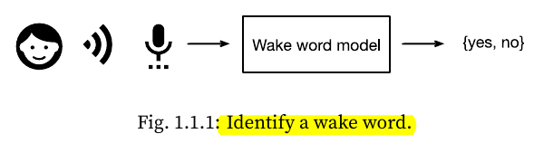
2. Model
Model denotes the computational machinery for ingesting data of one type, and spitting out predictions of a possibly different type.
Deep learning models consist of many successive transformations of the data that are chained together top to bottom, thus the name deep learning.
Notes:
Wake word is Alexa, Hey Siri, Hey Google,
Another example of face recognition where input is image and output is again yes/no. Finger print recognition

Slide 8
3. Objective Function
Learning means improving at some task over time.
Objective functions are formal measures to denote how good (or bad) a mathematical model is.
By convention, objective functions are defined so that lower is better.
Because lower is better, these functions are sometimes called loss functions.
Notes:
You can take any function for which higher is better, and turn it into a new function that is qualitatively identical but for which lower is better by flipping the sign.
squared error is the square of the difference between the prediction and the ground-truth.

Slide 9
4. Learning Algorithms
Learning Algorithm is an algorithm capable of searching for the best possible parameters for minimizing the loss function.
Popular algorithm for deep learning - gradient descent.

Slide 10
Example of the Framework
We have to tell a computer explicitly how to map from inputs to outputs.
We have to define the problem precisely, pinning down the exact nature of the inputs and outputs, and choosing an appropriate model family.
Collect a huge dataset containing examples of audio and label those that do and that do not contain the wake word.

Slide 11
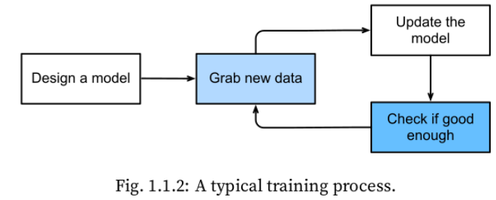
How to Create a Model?
Start with a program whose behavior is determined by a number of parameters.
How to determine the best possible set of parameters? Use data or examples.
Parameters improve the performance of the program with respect to the loss function.

Slide 12
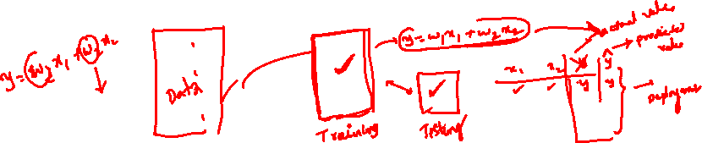
Train the Model
Train the program with data to find the best set of parameters that improves the performance of the program with respect to the loss function.
Once the parameters are finalised, we call the program a model.
    Eg: The model receives a snippet of audio as input, and the model generates a selection among yes / no as output.
The set of all distinct programs (input-output mappings) that we can produce just by manipulating the parameters is called a family of models.
    Eg: Same model family should be suitable for ”Alexa” recognition and ”Hey Siri” recognition because they seem, intuitively, to be similar tasks.

Slide 13
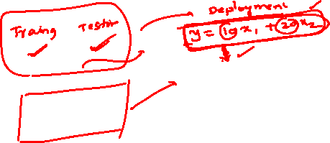
Kinds of Deep Learning Problems

Slide 14

Learning Problems
Supervised Learning
  Training by examples
  The model is given a dataset which has the data and its labels
  Eg: Classification, Regression
  You will learn this in this course and Machine Learning Course
Unsupervised Learning
  Situations where we feed the model a giant dataset containing only the features
  Eg: Clustering, Generate synthetic data (uses GAN)
  You will learn this in Advanced Deep Learning Course and Machine Learning Course
Reinforcement Learning
  Develop an agent that interacts with an environment and takes actions over a series of time steps.
  You will learn this in Deep Reinforcement Learning Course
Notes:
GAN – generative adversarial networks
Supervised learning is explained in the subsequent slides.
Reinforcement Learning is out of scope of this course.

Slide 15
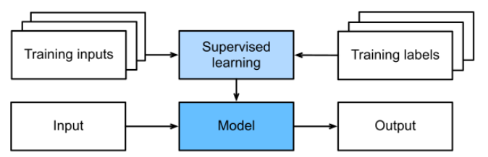
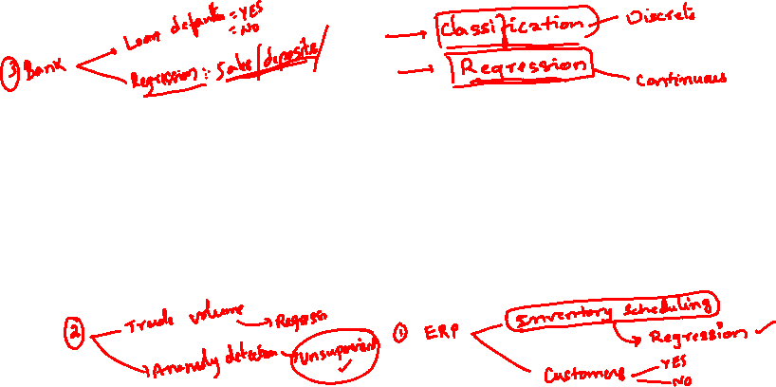
Supervised Learning
Each feature–label pair is called an example.
Goal is to produce a model that maps any input to a label prediction.
The supervision comes into play because for choosing the parameters, we (the supervisors) provide the model with a dataset consisting of labeled examples, where each example is matched with conditional probability of a label given input features.

Slide 16
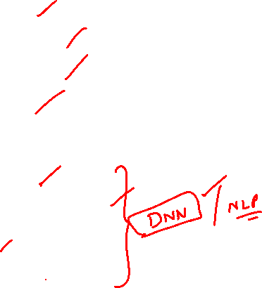
Supervised Learning Tasks
Regression
  how much or how many question
Classification
  Binary classification
  Multi-class classification
  Multi-label classification
Recommender systems
Sequence Learning
  Tagging and Parsing
  Automatic speech recognition
  Text to speech
  Machine translation

Slide 17
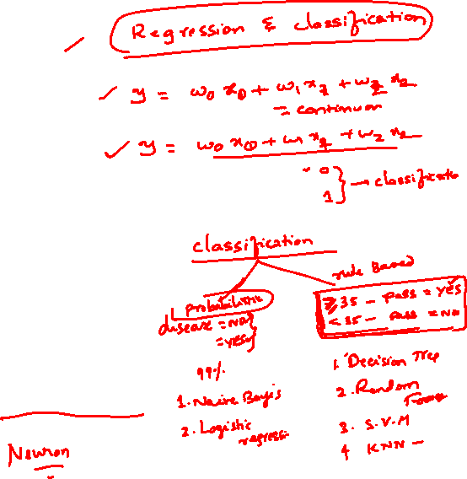
Module 2
(Perceptron)

Slide 18
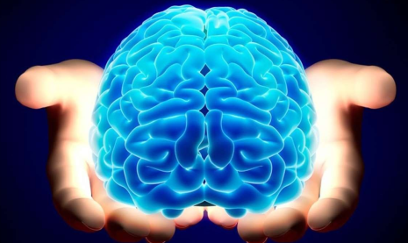

How do Humans Learn?
Human Brain
It begins with human brain.
Humans learn, solve problems, recognize patterns, create, think deeply about something, meditate and many many more.....
Humans learn through association. [Refer to Associationism for more details.]

Slide 19
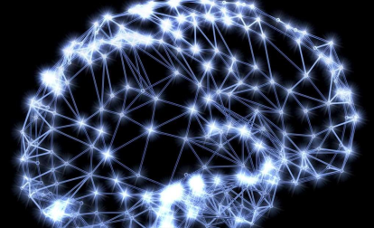

Observation: The Brain
Human Brain
The brain is a mass of interconnected neurons.
Number of neurons is approximately 10^(10).
Connections per neuron is approximately 10^(4 to 5).
Neuron switching time is approximately 0.001 second.
Scene recognition time is 1 second.
100 inference steps doesn't seem like enough. Lot of parallel computation.

Slide 20
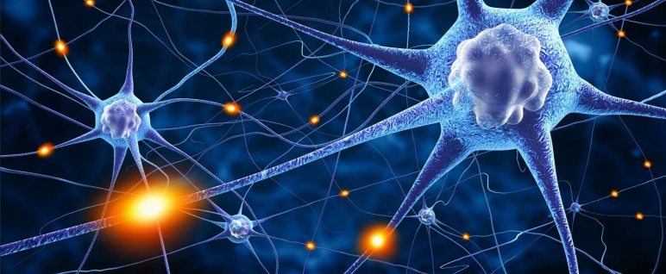

Brain: Interconnected Neurons
Human Brain
Many neurons connect in to each neuron.
Each neuron connects out to many neurons.

Slide 21
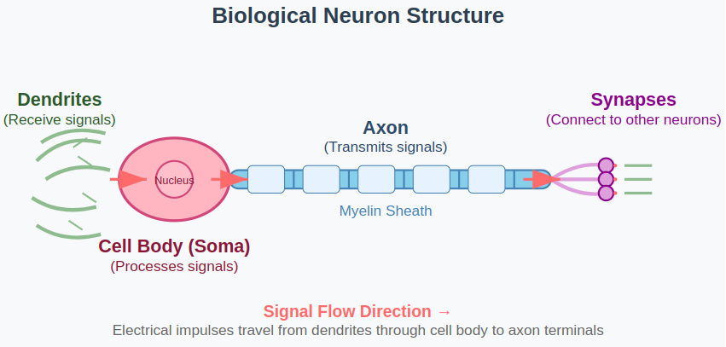
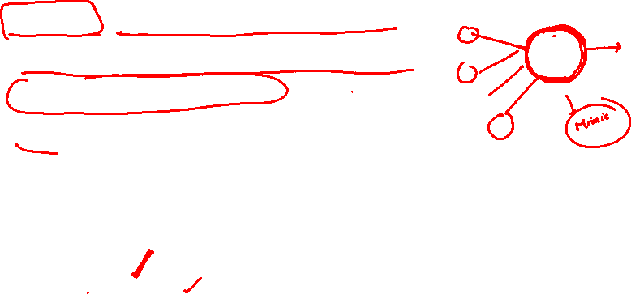
Biological Neuron
Key Components:
Dendrites: Receive signals from other neurons
Cell Body (Soma): Processes incoming signals
Axon: Transmits output signal
Synapses: Connection points between neurons

Slide 22
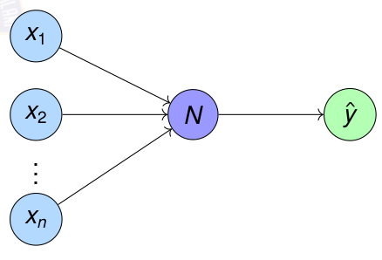
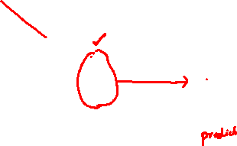
What are Artificial Neurons?
Artificial Neuron
Neuron is a processing element inspired by how the brain works.
Similar to biological neuron, each artificial neuron will be do some computation. Each neuron is interconnected to other neurons.
Similar to brain, the interconnections between neurons store the knowledge it learns. The knowledge is stored as parameters.

Slide 23
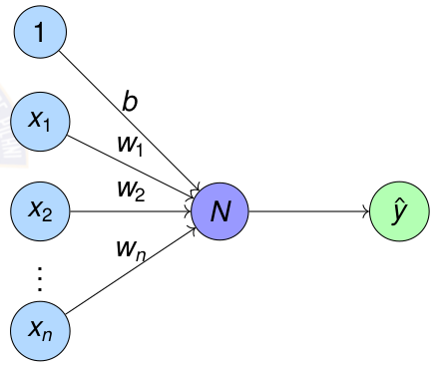
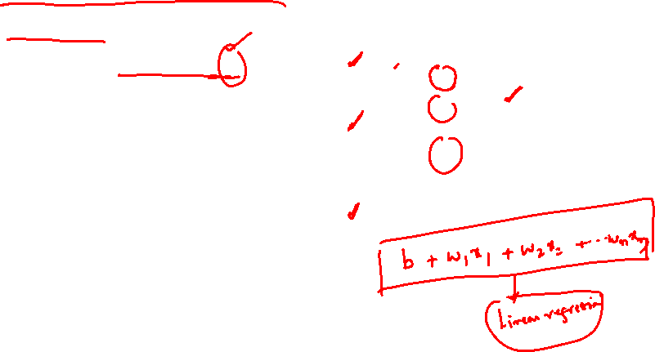
Artificial Neuron N
Artificial Neuron
Processing neuron N performs a very basic computation.
For each feature x_{i} , weight w_{i} shows the importance to the feature
N generates one numerical output ŷ

Slide 24
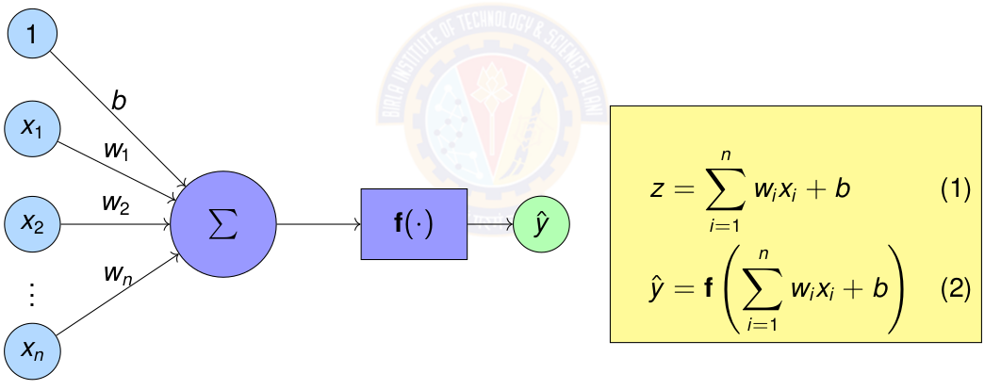
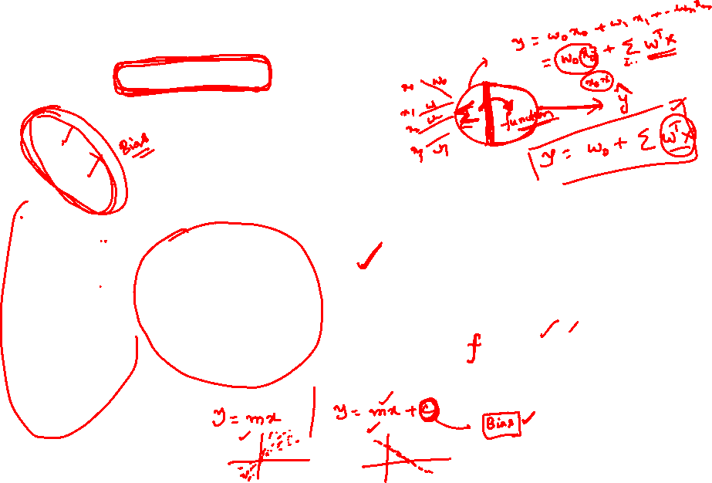
Artificial Neuron – Mathematical Computation
Sum of weights w_{i} times corresponding features x_{i}
Apply activation function f () on the sum.

Slide 25
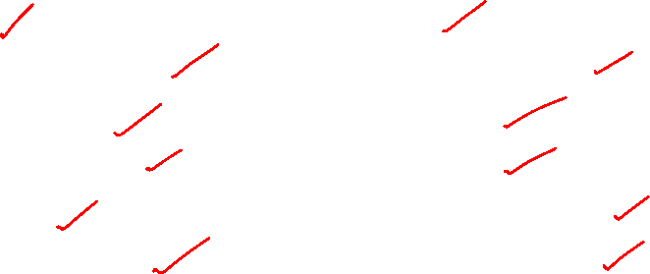
Comparison: Biological vs Artificial Neurons
Biological Neuron
Complex biochemical processes
Analog signal processing
Adaptive synaptic strengths
Parallel processing
Learning through experience
Fault tolerant
Artificial Neuron
Simple mathematical model
Digital computation
Adjustable weights
Parallel computation possible
Learning through algorithms
Deterministic behavior

Slide 26
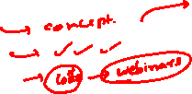
Artificial Neural Network (ANN)

Slide 27
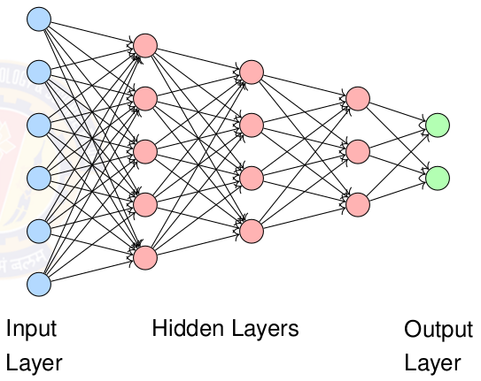
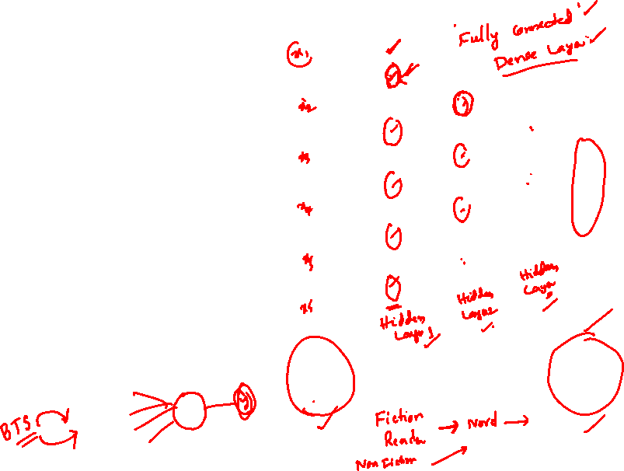
Artificial Neural Network (ANN)
Neural Network is a computational model inspired by human brain
Interconnected neurons process information
Interconnection can be forward, recursive or self loop
Learn patterns from data through training
Capable of approximating complex functions

Slide 28
Properties of Artificial Neural Network
Many neuron-like threshold switching units.
Many weighted interconnections among units.
Highly parallel, distributed process.
Emphasis on tuning parameters or weights automatically.

Slide 29
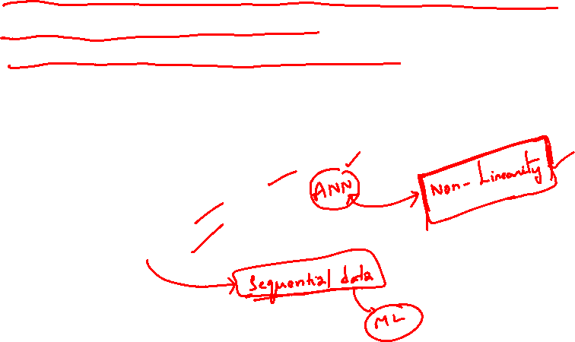
When to consider Artificial Neural Networks?
Input is high-dimensional discrete or real-valued (e.g. raw sensor input).
Possibly noisy data. Data has lots of errors.
Output is discrete or real valued or a vector of values.
Form of target function is unknown.
Human readability, in other words, explainability , of result is unimportant.
Examples:
  Speech phoneme recognition
  Image classification
  Financial prediction

Slide 30
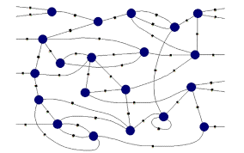
Connectionist Machines
Network of processing elements, called artificial neurons neuron
The neurons are interconnected to form a network.
Interconnection can be forward, recursive or self loop
All world knowledge is stored in the connections between these elements.
Neural networks are connectionist machines.

Slide 31
Connectionism Principles
Core Ideas:
Intelligence emerges from simple processing neurons
Knowledge is stored in connection weights
Learning modifies connection strengths
Parallel distributed processing

Slide 32
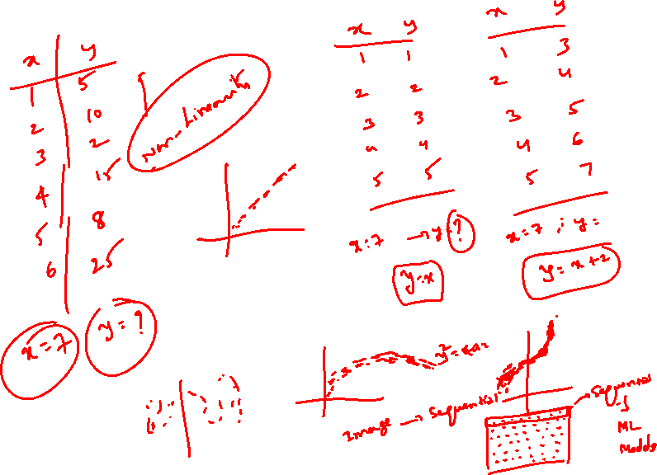
Perceptron

Slide 33
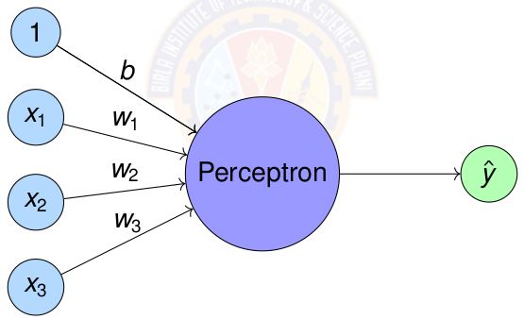
Perceptron
Perceptron = Simplest form of artificial neuron
Perceptron was introduced by Rosenblatt in 1958.

Slide 34
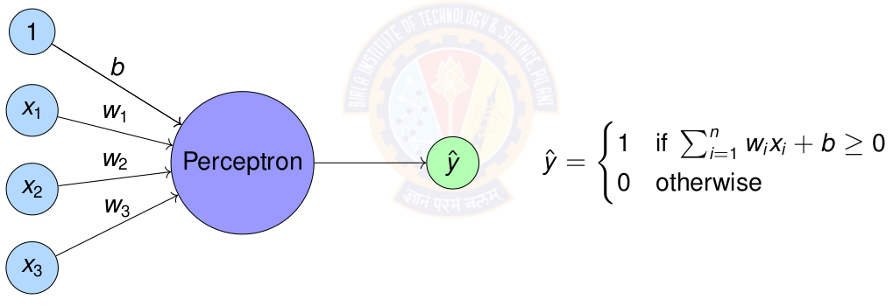
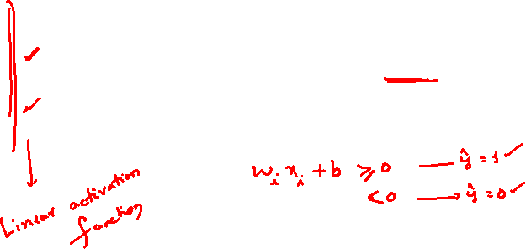
Perceptron
Perceptron = Simplest form of artificial neuron

Slide 35
Perceptron & Logic Gates

Slide 36
Perceptron
Any linear decision can be represented by a Boolean equation.
The quest is to find out how to represent the above using Perceptron.
For this we test whether each of the logic gates can be represented by a Perceptron.

Slide 37
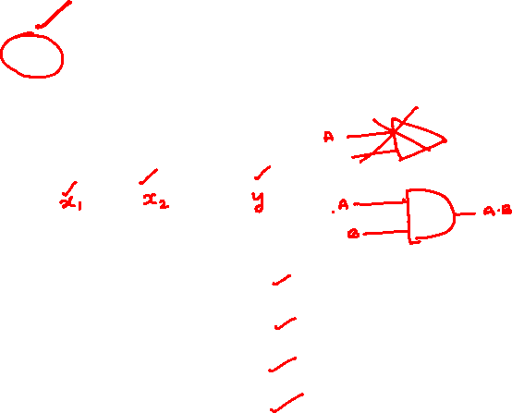
AND Logic Gate
Question:
How to represent AND gate using a perceptron?
What are the parameters for the AND perceptron?
Data is given below.
A | B | A and B
0 | 0 | 0
0 | 1 | 0
1 | 0 | 0
1 | 1 | 1

Slide 38
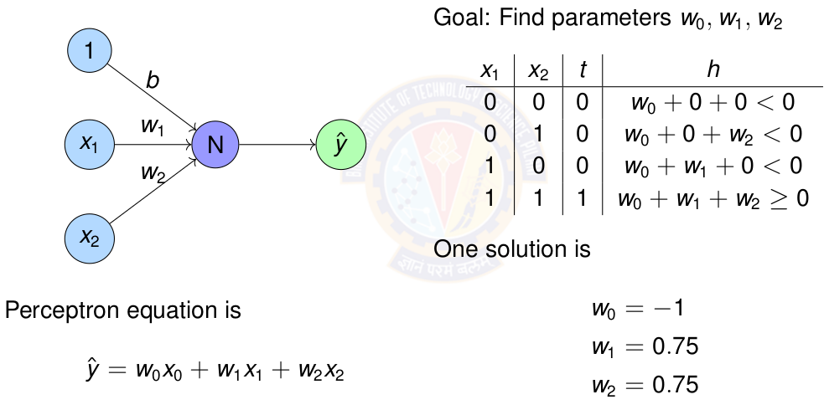
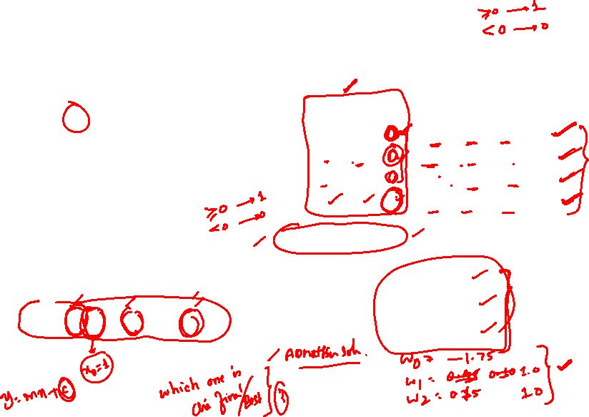
Perceptron for AND gate

Slide 39
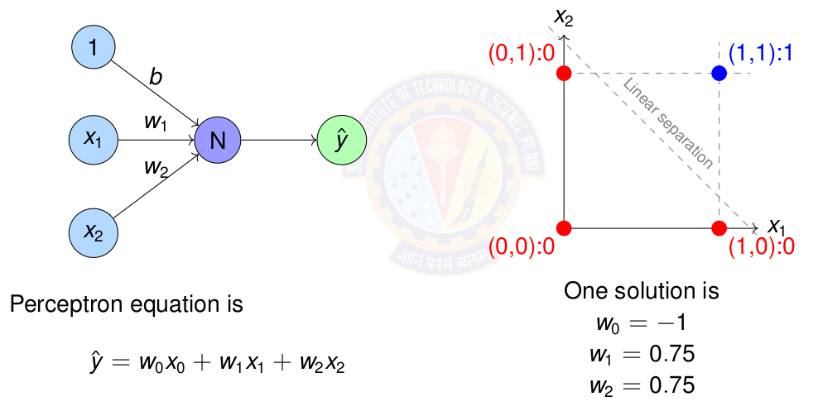
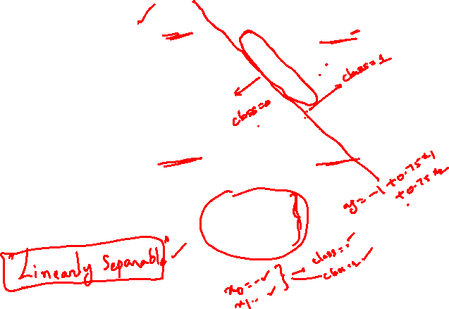
Perceptron for AND gate

Slide 40
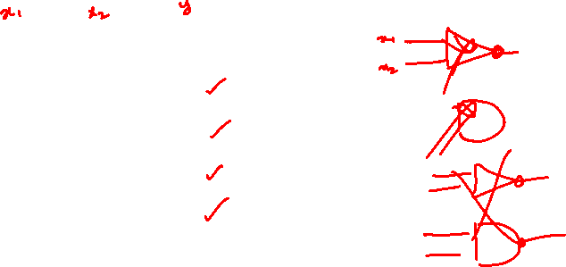
OR Logic Gate
Question:
How to represent OR gate using a perceptron?
What are the parameters for the OR perceptron?
Data is given below.
A | B | A or B
0 | 0 | 0
0 | 1 | 1
1 | 0 | 1
1 | 1 | 1

Slide 41
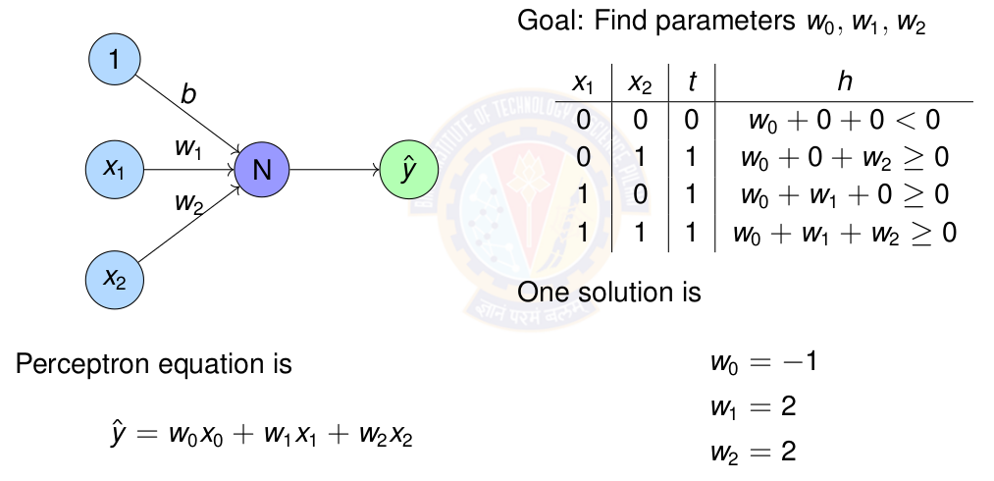
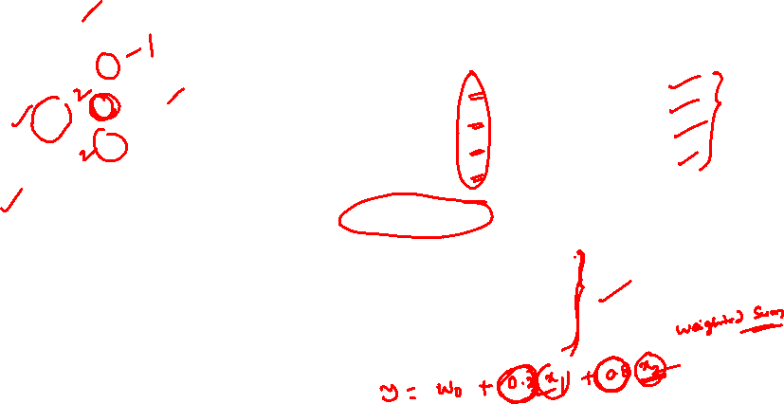
Perceptron for OR gate

Slide 42
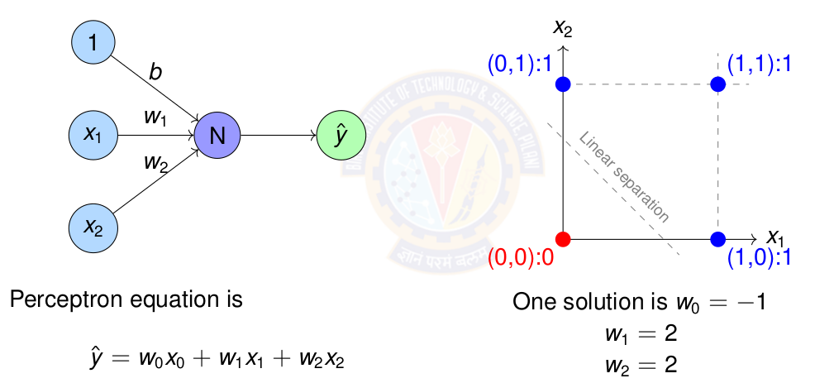
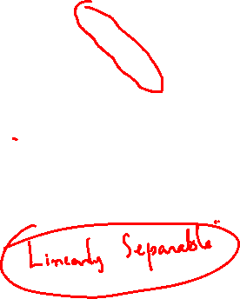
Perceptron for OR gate

Slide 43
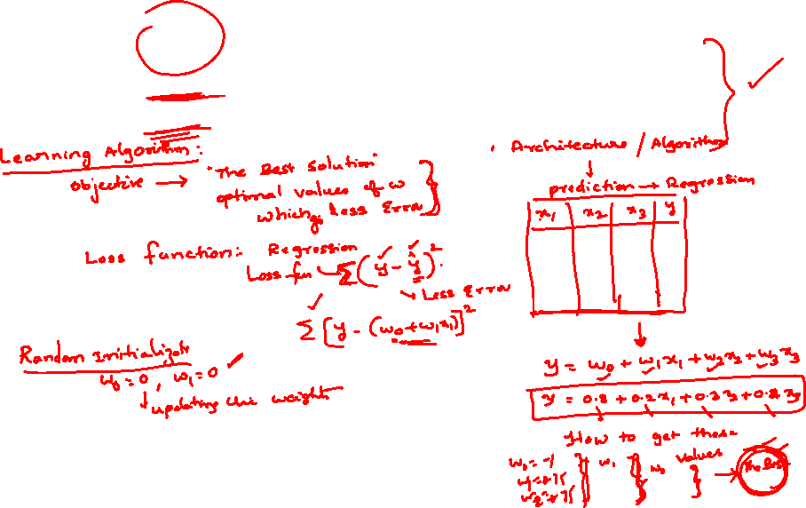
Exercise
Represent OR gate using Perceptron. Compute the parameters of the perceptron.
Represent NOR gate using Perceptron. Compute the parameters of the perceptron.
Represent NAND gate using Perceptron. Compute the parameters of the perceptron.

Slide 44
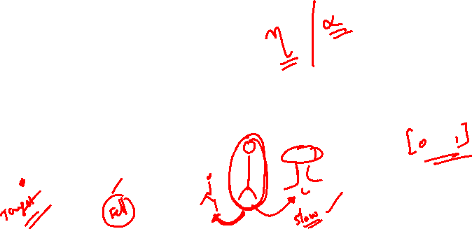
Perceptron Learning Algorithm

Slide 45
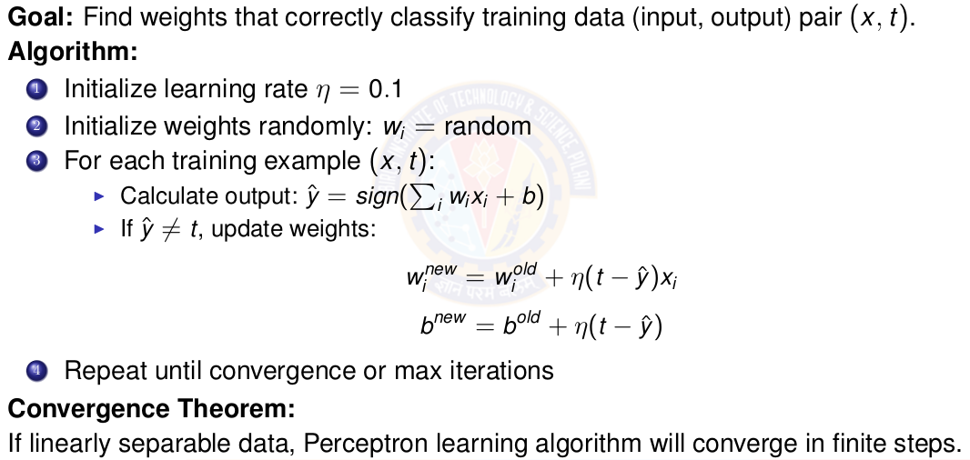
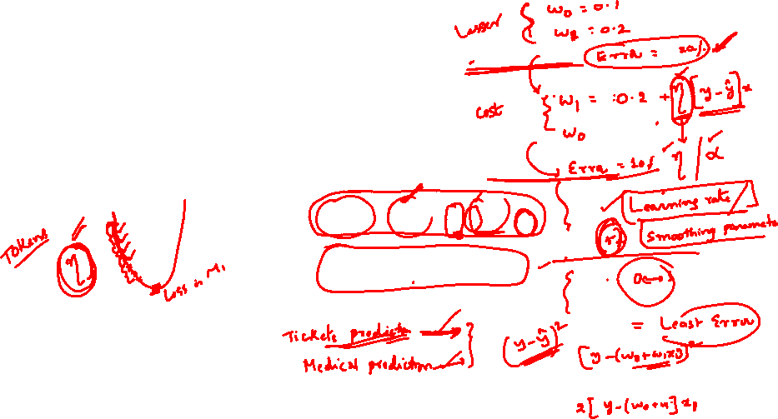
Perceptron Learning Algorithm

Slide 46
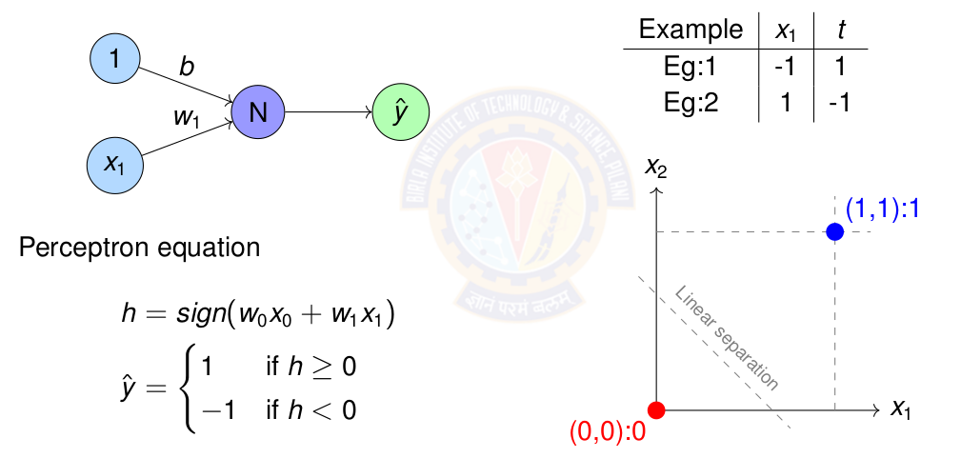
Perceptron Learning for NOT gate

Slide 47
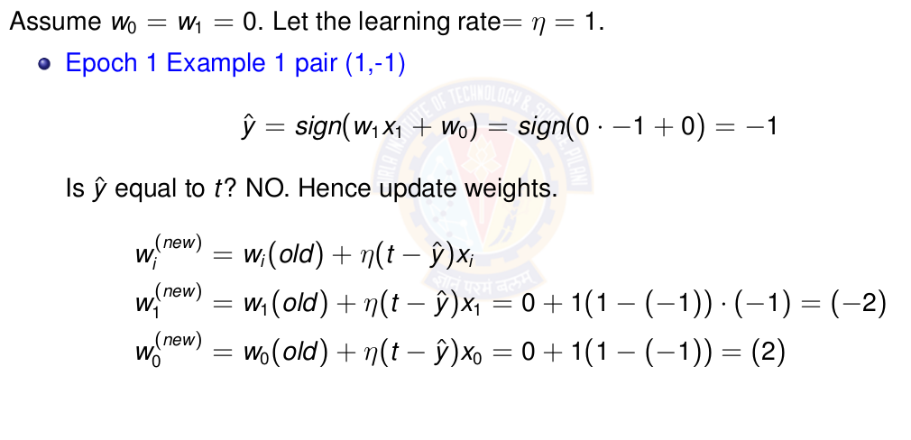
Perceptron Learning for NOT gate

Slide 48
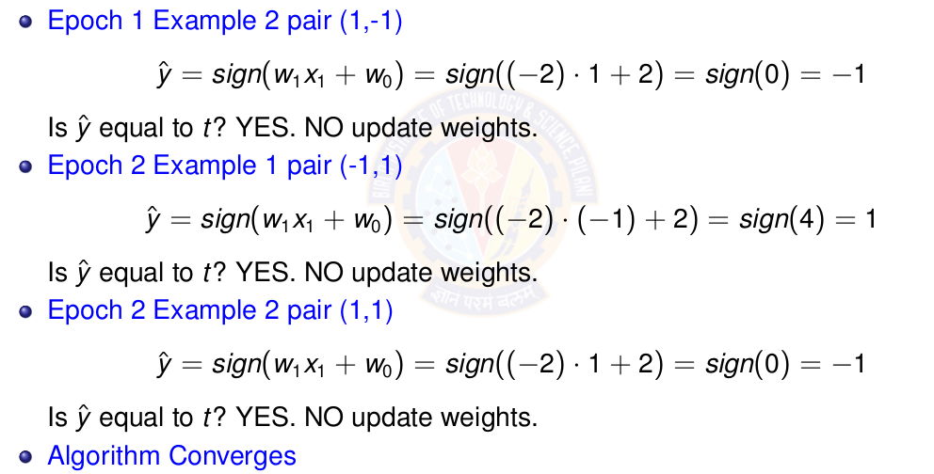
Perceptron Learning for NOT gate

Slide 49


The XOR Problem

Slide 50

Why Single Perceptron Fails on XOR

Slide 51
Perceptron Demo Python Code
https://colab.research.google.com/drive/1DUVcOoUIWhl8GQKc6AWR1wi0LaMeNkgD?usp=sharing
Student pl note:
The Python notebook is shared for anyone who has access to the link and the access is restricted to use BITS email id. So pl do not access from non-BITS email id and send requests for access.

Slide 52
Linearly Separable Data

Slide 53
Linearly Separable Data
Two sets data points are separable in a n-dimensional space if they can be separated by an (n-1) dimensional hyperplane.
A straight line can be drawn to separate all the data examples belonging to class +1 from all the examples belonging to the class -1. Then the two-dimensional data are clearly linearly separable.
An infinite number of straight lines can be drawn to separate the class +1 from the class -1.

Slide 54

Linearly vs Non-Linearly Separable Data

Slide 55
Perceptron for Linearly Separable Data
Data
  Truth tables or set of examples
Model
  Perceptron
  Inputs x are the features or columns
  Target output t is the required label
Objective Function
  Deviation of desired output or target t and the computed output ŷ
Learning Algorithm
  Perceptron Learning algorithm
Challenge
  How to learn these n + 1 parameters w₀ , w₁ . w₂ . . . w_{n} ?
Solution
  Use Perceptron learning algorithm.

Slide 56

Perceptron for Linearly Separable Data

Slide 57
Exercise
Represent OR gate using Perceptron. Compute the parameters of the perceptron using perceptron learning algorithm.
Represent AND gate using Perceptron. Compute the parameters of the perceptron using perceptron learning algorithm.
Represent NOR gate using Perceptron. Compute the parameters of the perceptron using perceptron learning algorithm.
Represent NAND gate using Perceptron. Compute the parameters of the perceptron using perceptron learning algorithm.
Implement a perceptron for AND and OR gates
Sketch decision boundaries for Single perceptron

Slide 58
Key Concepts
Neural Network: Biological inspiration and mathematical models
Perceptron: Simplest neural unit, linear classification, learning algorithm
XOR Problem: Limitation of linear models, need for hidden layers
Learning Paradigms: Supervised, unsupervised, reinforcement learning

Slide 59
References
Zhang et al. "Dive into Deep Learning" - Chapter 1 https://d2l.ai/
http://mlsp.cs.cmu.edu/people/rsingh/docs/Chapter1_Introduction.pdf
Goodfellow, Bengio, Courville - "Deep Learning" Chapters 1-6
Rosenblatt, F. (1958) - "The Perceptron: A Probabilistic Model”
Minsky & Papert (1969) - "Perceptrons" (Historical perspective)

Slide 60



